Slide 1

ORBYTE SMART SME CHALLENGE · DOMAIN 2
SOPBox
Smart receiving checks inventory
for F&B SMEs
AI reads and drafts. Rules check. Humans
approve.
A practical check at the point stock enters the kitchen.

Slide 2
A FAMILIAR SHIFT
Too much to remember by
10:15
hand
Each product brings its own rules, units and records.
The supplier is at
the door.
01
Different temperature ranges, holding times and
storage places for each product items.
Busy shift. Staff are
receiving and preparing
products at once.
New Staff with no sufficient
training time.
02
Bundle sizes vary each product;
Time consuming for staff to check pack conversions.
03
Weekly and monthly stock counts consume time
and manpower.
· Illustrative scenario by personal experience ·

Slide 3
THE DECISION MODEL
AI reads and drafts. Rules check. Humans
approve.
Staff confirm extracted data before any stock decision is submitted.
AI reads & drafts
Rules check
Humans approve
Draft product SOPs and
read typed, scanned or
handwritten Delivery
Orders.
Temperature against the
product range; pack
conversion; quantity
against the PO.
Any exception goes to a
manager with its photo
evidence and details.
Staff review and confirm
the suggested details.
The pass/fail checks are
deterministic—not an AI
decision.
Accept, reject, return or
split the decision—with
a reason.

Slide 4






FEATURES
Everything a receiving check needs, on the
phone your staff already carry
Temperature checks
Pack conversion
SOP cards and search
Category or product
Convert bundles to base
units so short deliveries
And stock count are
easy to conduct.
Eg: 1 bundle = 250 pcs
Find receiving, storage
and handling
instructions from any
phone.
based ranges; save a
probe reading on
each line.
Telegram alerts
Full audit log
Roles and separate
Alert managers to failed
checks; keep staff
informed of decisions.
Record who received,
who decided, when, and
every reading.
workspaces
Owner, manager and
staff roles; each
Business and user sees
only its own data.

Slide 5
SDG IMPACT & API USAGE
Practical workflow, wider goals
SDG 12 · Responsible consumption
Technology & APIs
Targets 12.3 and 12.5: flag questionable
stock before acceptance and support
more informed ordering.
UI · React, TypeScript, Vite, Tailwind
API & data · Python FastAPI REST,
PostgreSQL
SDG 8 · Decent work
AI & alerts · RunPod vLLM/Qwen3-VL,
Telegram Bot API
Targets 8.2 and 8.3: practical digital tools
and repeatable procedures for F&B SMEs.

Slide 6
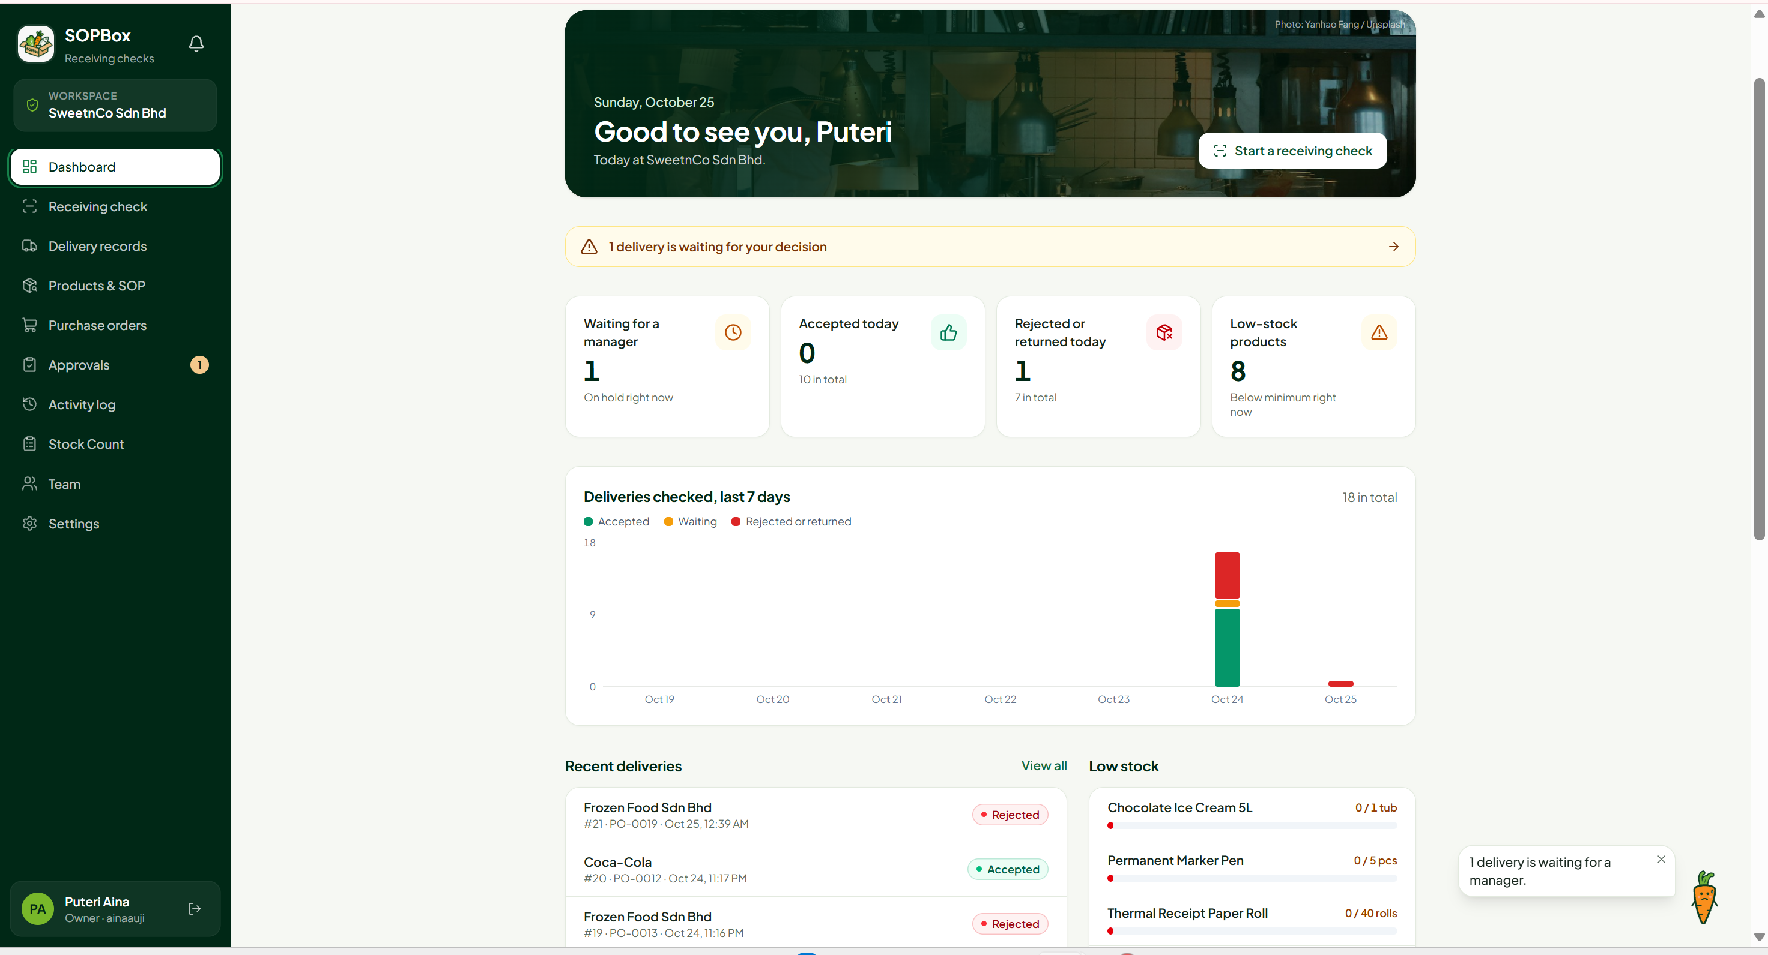

Slide 7
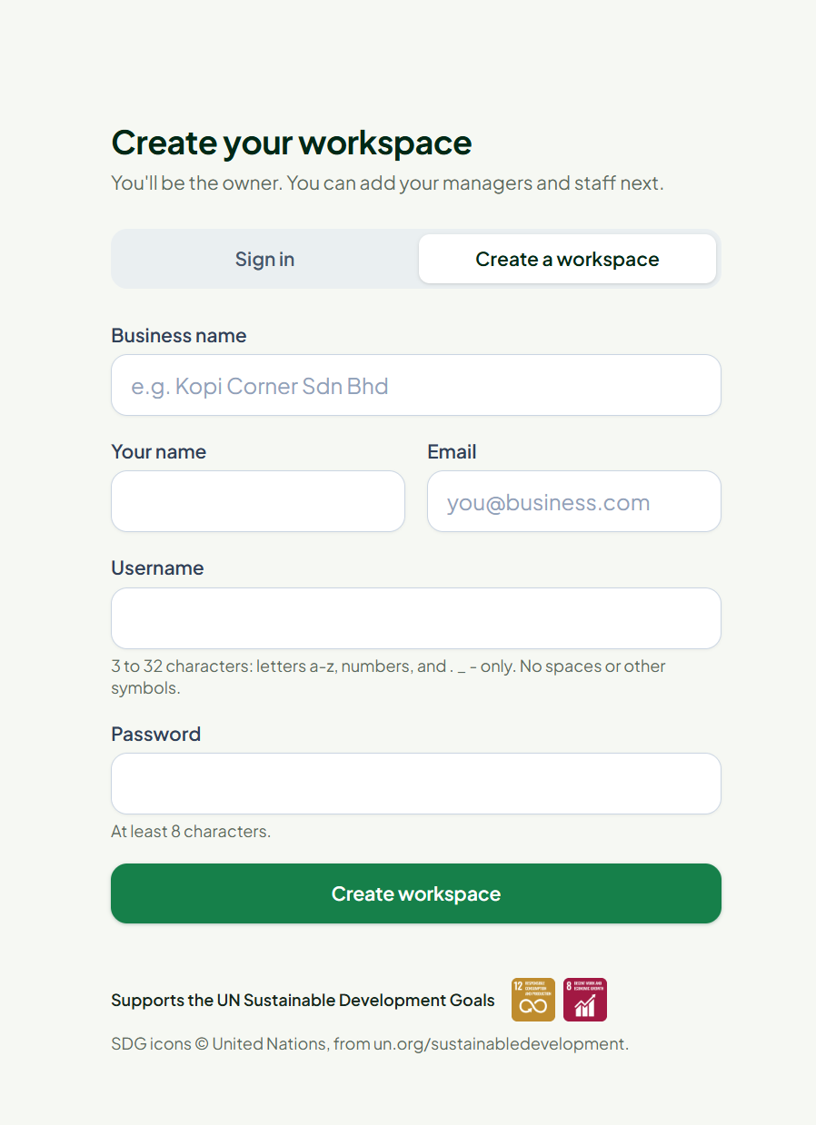
LIVE DEMO · SETUP
1 · Set up the workspace
Begin as the owner, then prepare the product catalogue
and the team.
01
02
Workspace
Invite team
Owner creates the
outlet workspace.
Give each invited user
only the access they
need.
Owner sets up the team
Manager oversees · Staff receive

Slide 8
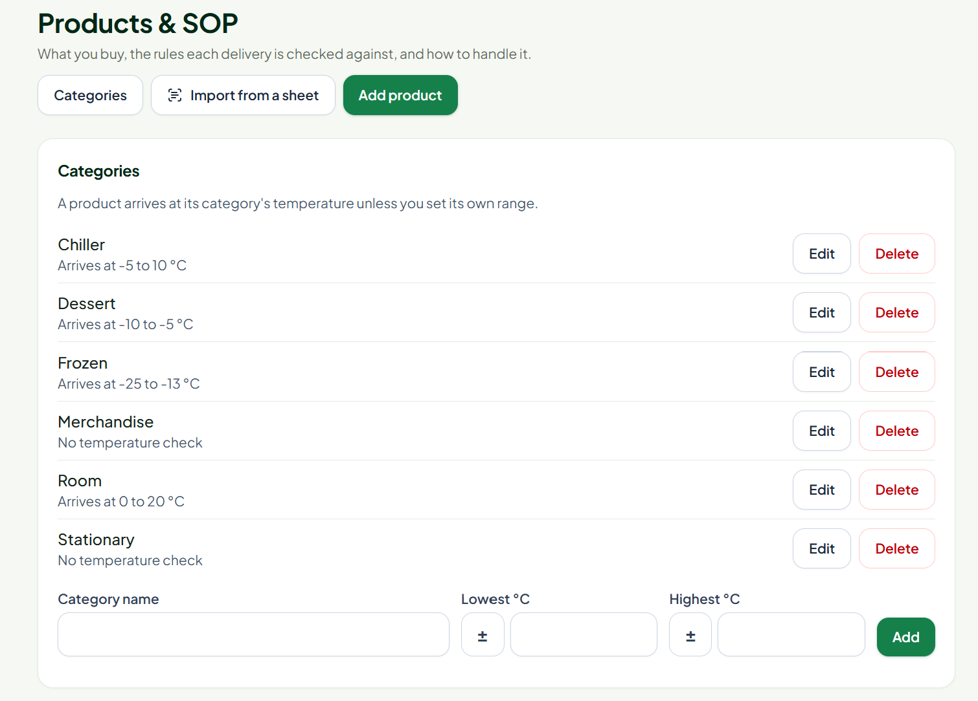
LIVE DEMO · SETUP
1 · Set up the workspace
Begin as the owner, then prepare the product catalogue
and the team.
03
Category
Create a category to
organize products.
Owner sets up the team
Manager oversees · Staff receive

Slide 9
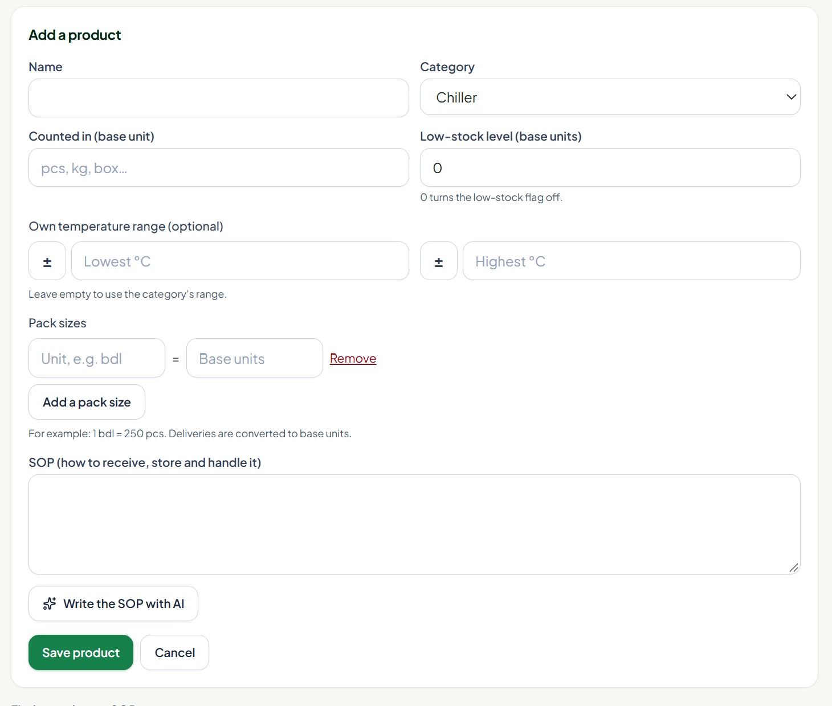
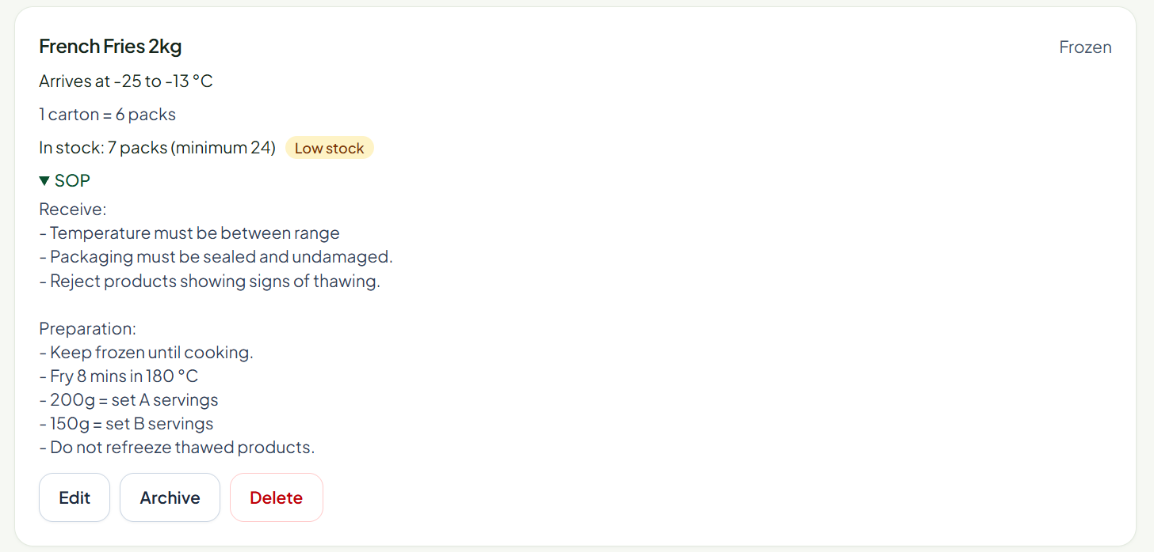
LIVE DEMO · SETUP
1 · Set up the workspace
Begin as the owner, then prepare the product catalogue
and the team.
04
Product + SOP
Add product rules;
use AI to help draft its
SOP.
Owner sets up the team
Manager oversees · Staff receive

Slide 10
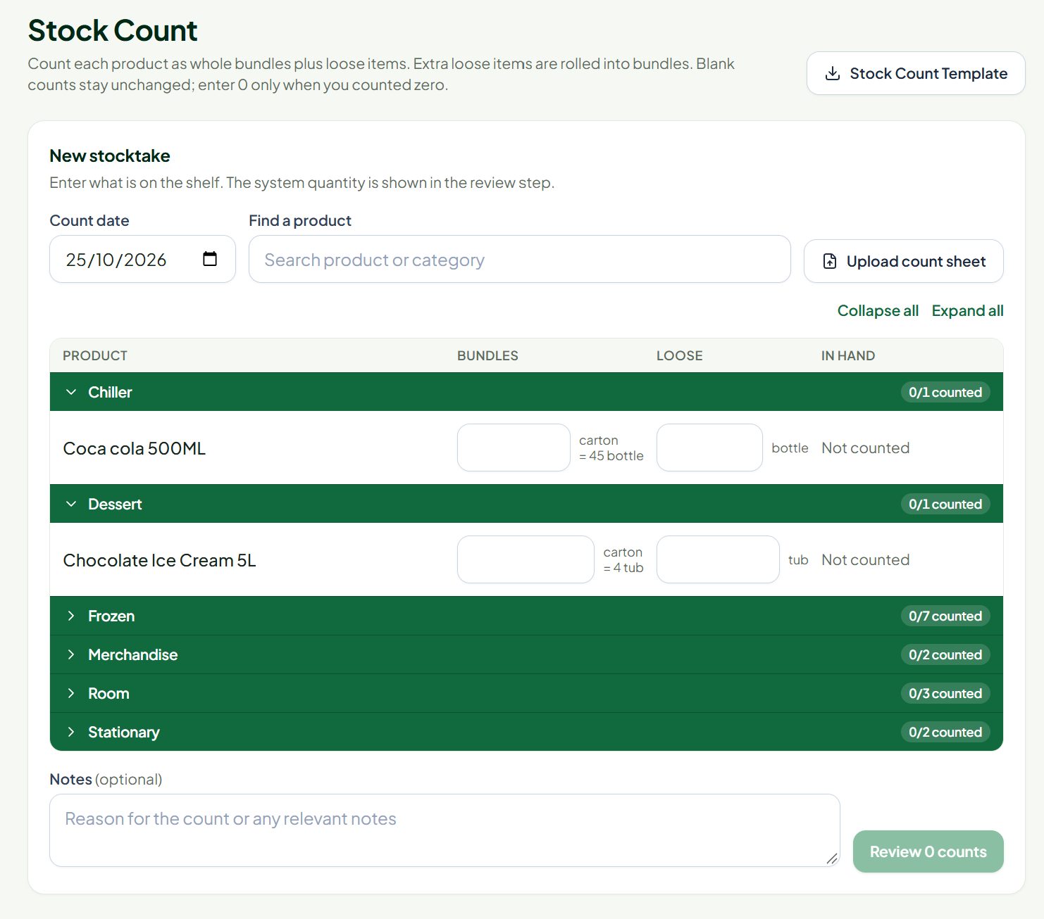
LIVE DEMO · STOCK & ORDERING
2 · Count stock, then prepare a PO
STOCK COUNT
Count it your way
Enter counts directly in SOPBox, or
use the Excel template and upload
the completed file.
Update stock records from the count.
Simplify the process by directly count
the bundle and loose item.

Slide 11
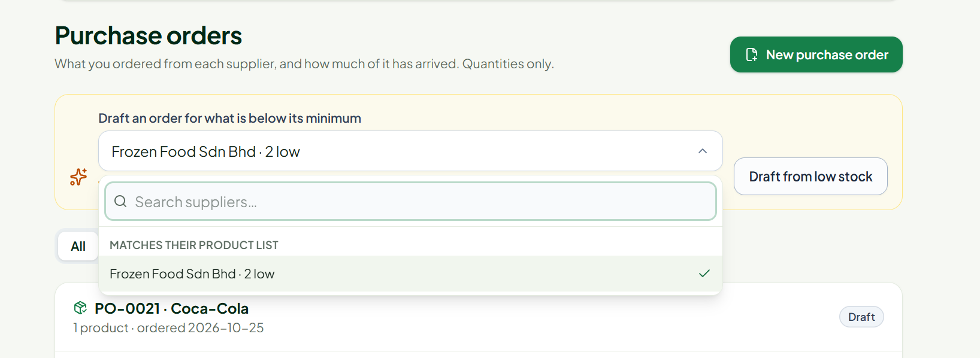
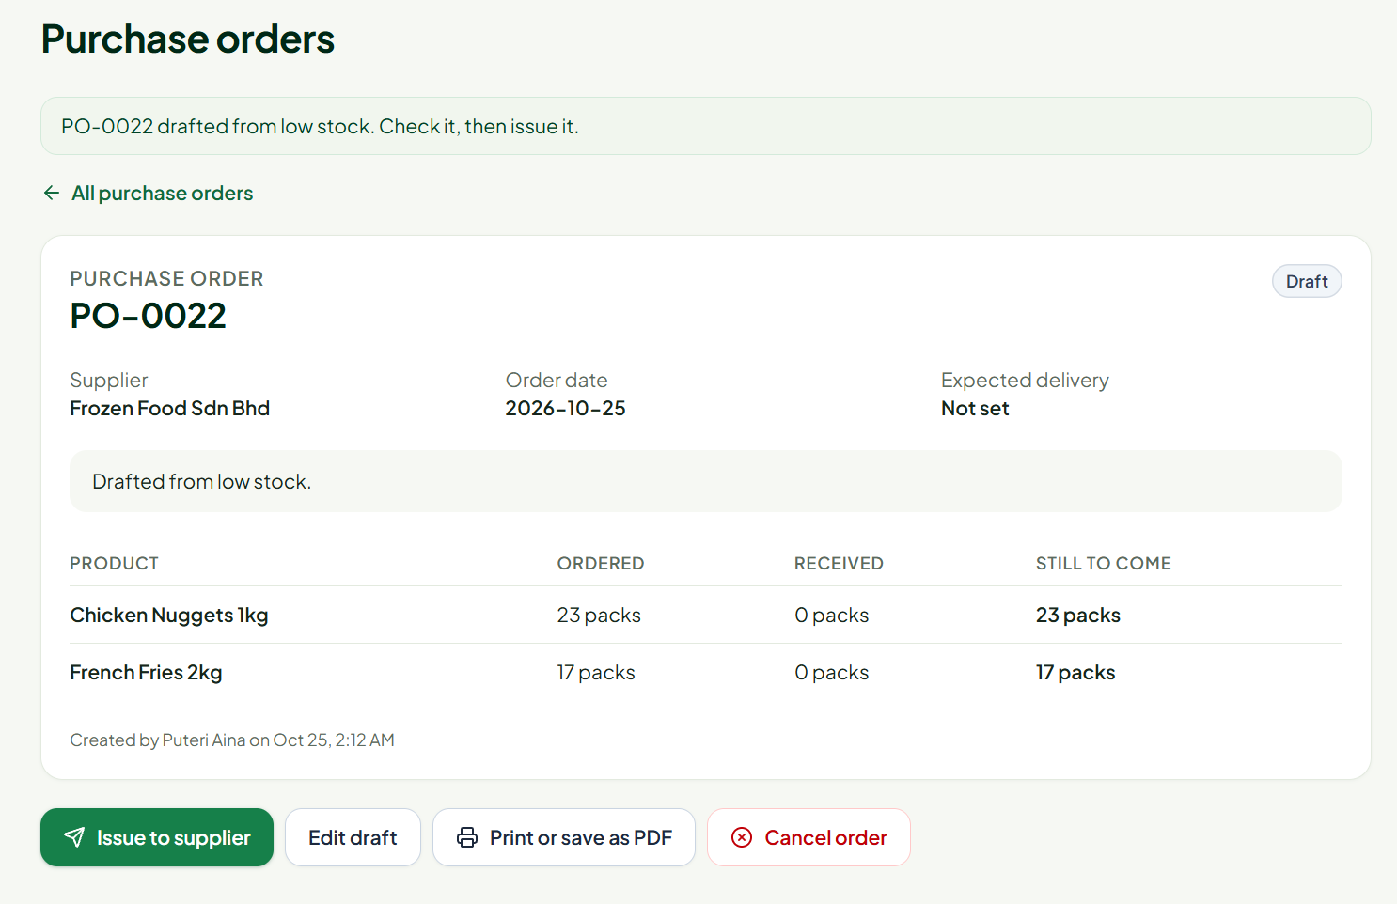
LIVE DEMO · STOCK & ORDERING
2 · Count stock, then prepare a PO
PURCHASE ORDER
Low stock → draft →
issue
1. Draft an order for products below
their threshold.
2. Review and confirm the supplier and
quantities.
3. Issue the PO; print it or
save/download as PDF.

Slide 12
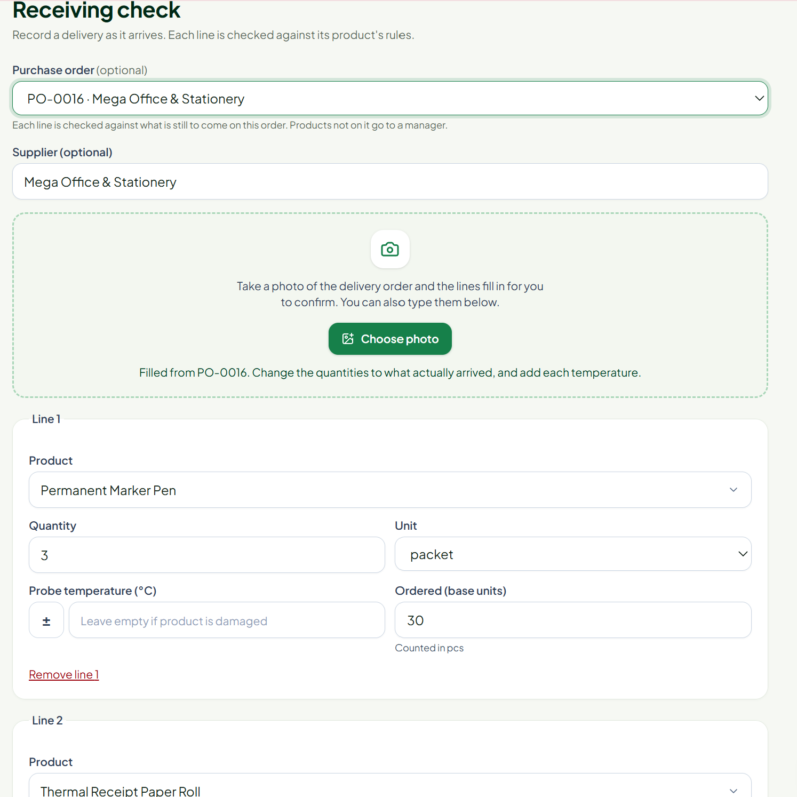
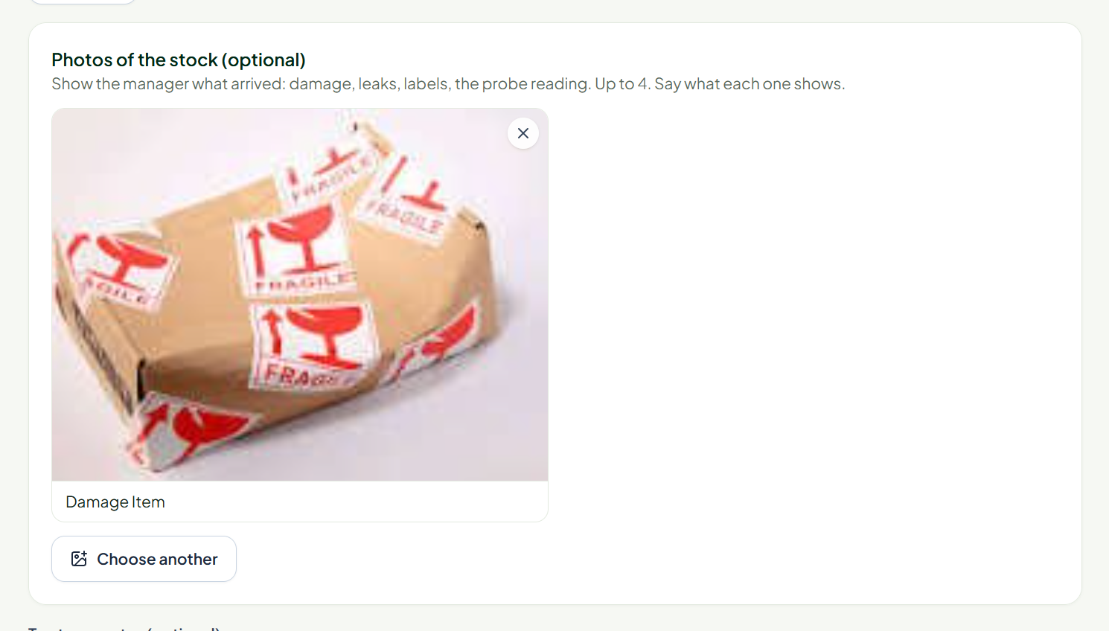
LIVE DEMO · RECEIVING & APPROVALS
3 · Match the DO, check, resolve
01
Select the issued PO that matches the delivery.
02
Upload the DO. AI reads a document, scanned
PDF or handwritten page.
03
Review and correct the lines, confirm, then save
and submit.
Short or damaged?
Manager decision
Attach a photo as evidence,
then send the issue for
approval.
Accept · reject · return · partial
decisions by line
Record a reason for the
decision.

Slide 13
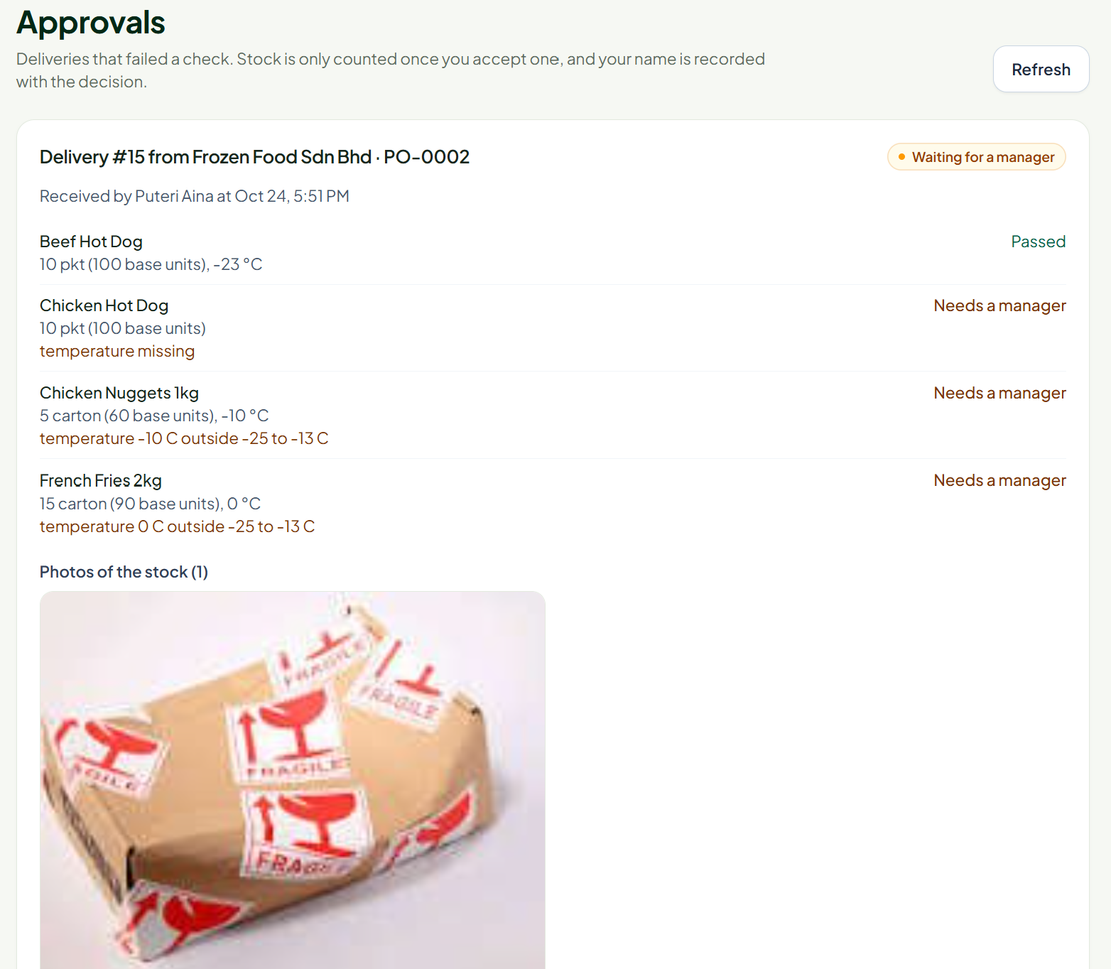
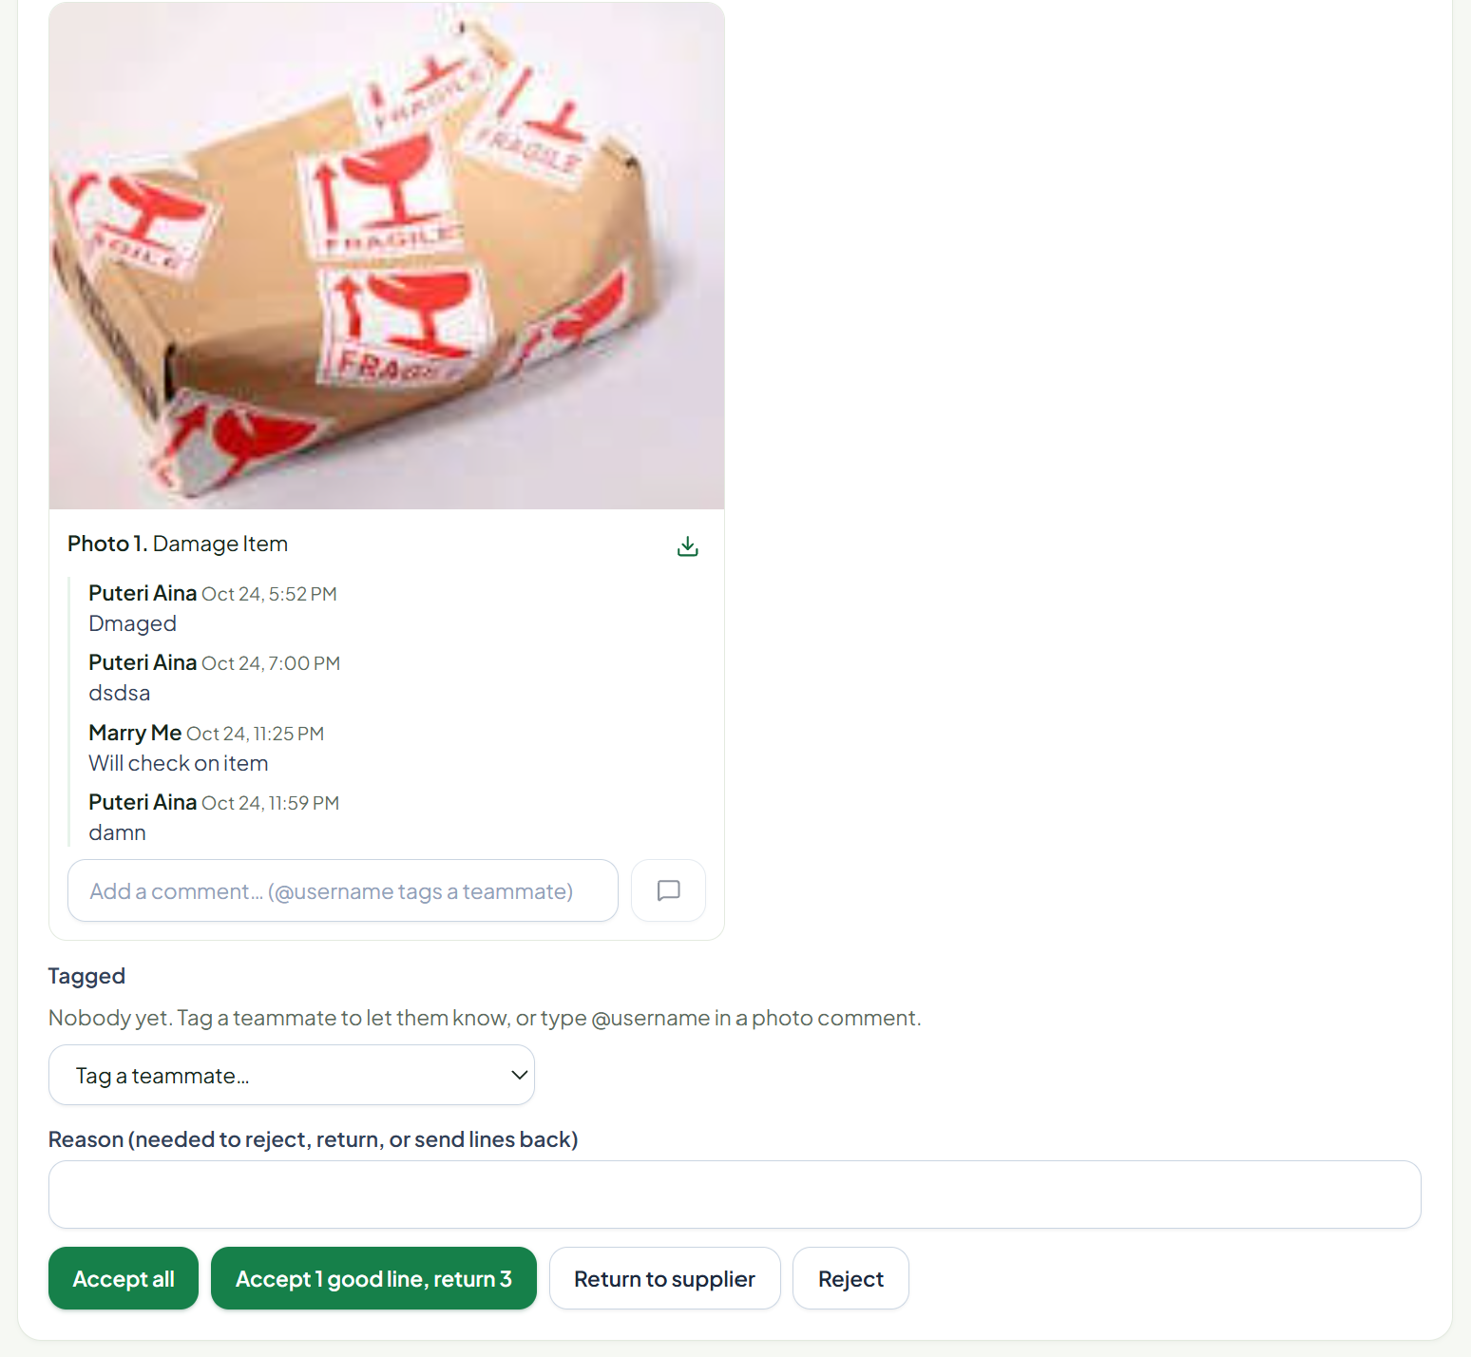
APPROVALS
Handle exceptions.
RECEIVING ISSUES
Partial · incorrect · damaged
Approval required
An owner, manager or chosen staff
member reviews each issue.
Add a photo and reason. Approve, reject,
return or decide by item.

Slide 14
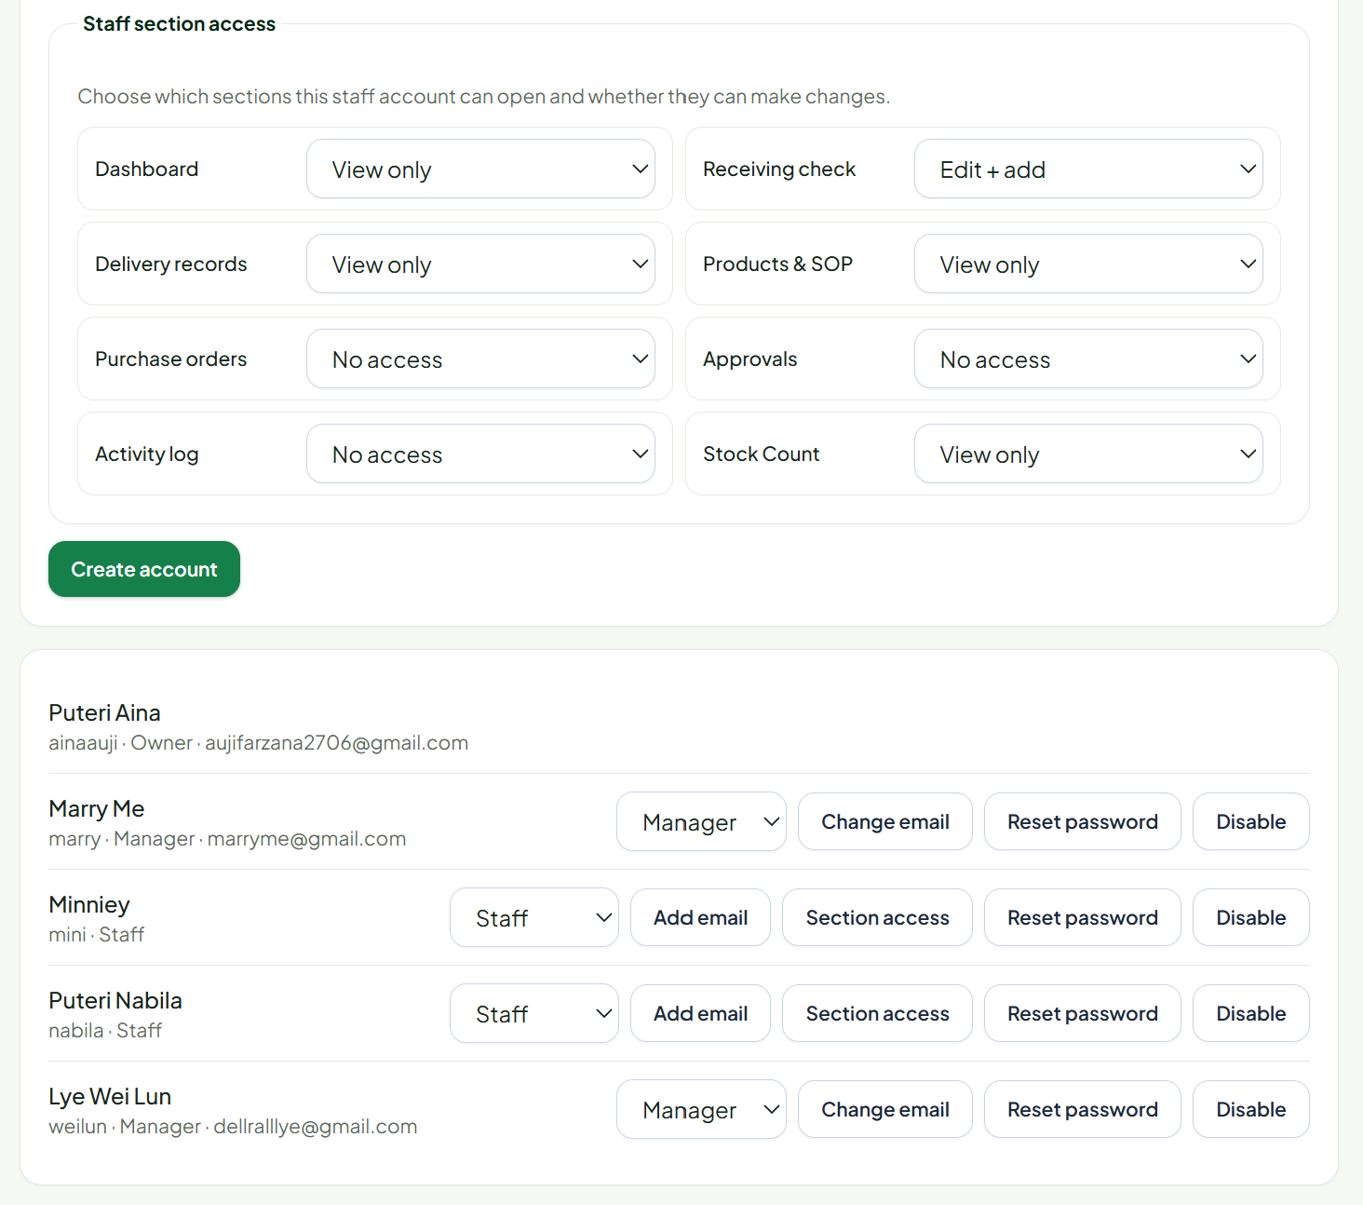
ACCESS
Manage user access.
USER MANAGEMENT
Roles and access
Owner invites managers and staff.
Assign a role and limit each person to
selected functions.
Separate workspaces keep each
business’s users and records private.

Slide 15

SOPBOX · SMART RECEIVING CHECK
A clearer flow for
every job scope.
AI reads and drafts. Rules check. Humans approve.
Thank you ·

